Slide 1



Technical Proposal
Document Type | Technical Proposal
Document Version | V1.0
Document Prepared By | HTI Telecom
Document Start Date | 29.03.2022
Document End Date | 31.03.2022

Slide 2

HTI TELECOM CURRENTLY EXISTED CACHING/FORWARDING
AUTHORITATIVE DNS OVERVIEW DESIGN

Slide 3
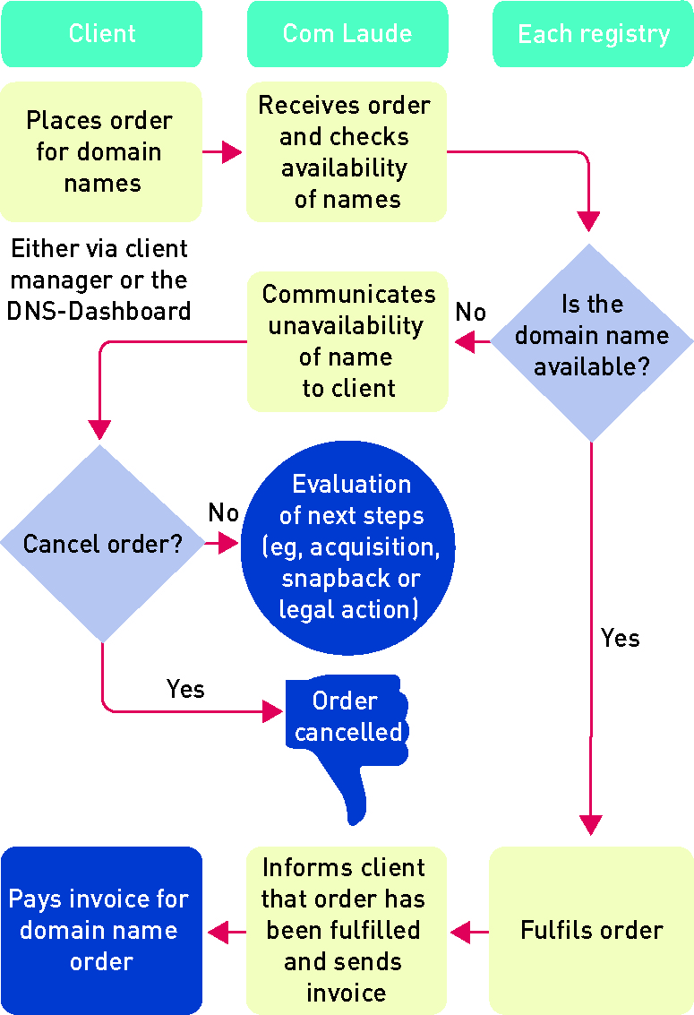
Domain Name Registration Procedure
Customer
HTI / Sub Root
Domain Registrar
Registry
Customer shall submit an application to register one or more Domain Name by manners stipulated by us. We notifies the fee for registration of Domain Name. On payment of the fees, and after acceptance of the application, We may proceed with the designated procedure. Domain Name shall only be deemed to be registered after the Registration Information has been recorded in the database of the Registry.

Slide 4
Domain Name Registration Period
Domain Name shall continue to be valid for the period initially selected by customer (the “Initial Period”). If a Domain Name Registration is renewed, such Domain Name shall continue to be valid for the period selected by customer (the “Renewal Period”). The Initial Period and Renewal Period shall be collectively referred to as the “Registration Period”. The Registration Period may not be modified except in accordance with this Order or Detailed Regulations. We reserve the right to extend the Registration Period based on any decisions made by ICANN, the Registry of the Domain Name or applicable laws.
Provisions of Services. We will provide the following services to customer:
(a) The registration of a Domain Name;
(b) The renewal of a Domain Name Registration;
(c) The transfer of a Domain Name;
(d) The administration of a registered Domain Name;
(e) The provision of DNS settings for a registered Domain Name; and
(f) The Whois Protection Service;
(g) The services related to (a) to (f) above

Slide 5
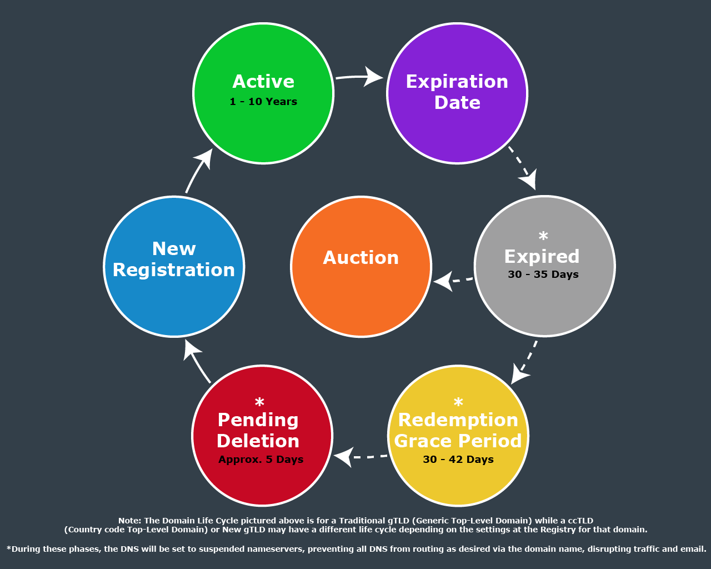
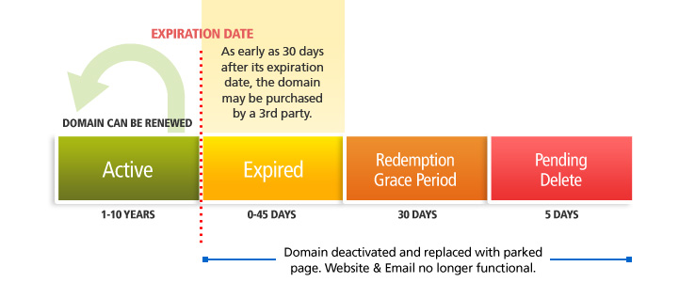
Domain Name Registration Period
Domain Registration Life Cycle
The Life Cycle Of a Domain
ENJOY THE BEST INTERNET IN MYANMAR

Slide 6
Maintenance System For DNS Services
In the maintenance scope, we do the scheduled maintenance by daily, weekly, monthly and yearly based on the system and components such us; Network, Firewall, Hardware & Software Maintenance, malware detection, Server Troubleshooting etc.
During the Term of Services, we will perform the repair or maintenance services at our own cost on the infrastructure and related network structure to provide the service to the customers. If a damage to the Services is as a result of misuse or abuse of the system or component (such as, but not limited to, use of incompatible devices or accessories, or failure to follow operating instructions) by the customer, the costs of maintenance services shall be borne by the customer.
For items regarding maintenance and management of the corresponding Domain Name registration under the authorization of the Registrant of the corresponding Domain Name and is listed in the registration information of the Domain Name. The Registrant may also be a Contact Person.
Connection to the Registry’s EPP system
We do not have any connection to the Registry’ EPP system. We consider to use the connection with EPP and a web-based provide by PTD which will be EPP platform for ‘.mm’ domain name registration. In future, we are going to connect with our end user platform by the recommendation and required technical support of PTD.

Slide 7
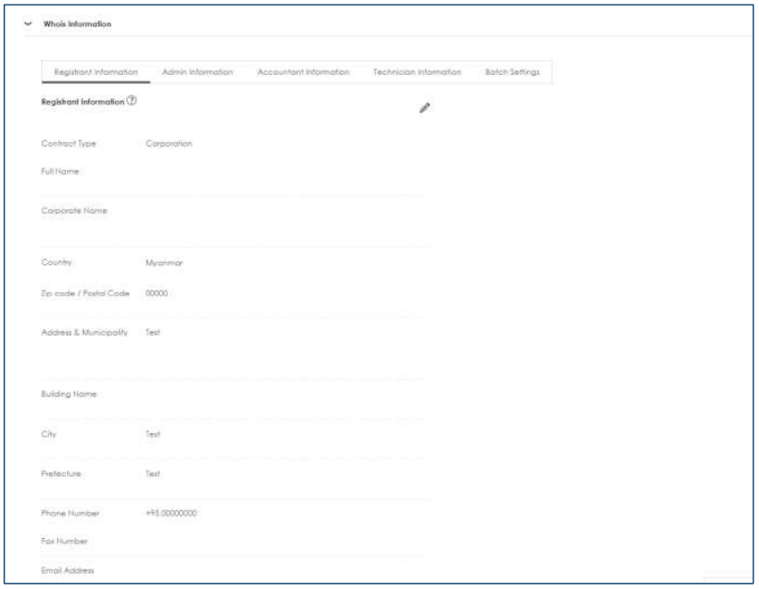
Whois Service
By applying Whois Protection Service, customer may keep customer’s name, postal address, email address and phone (We may, in its sole and absolute discretion, decide the type of information customer may apply Whois Protection Service) for the Contact Person private, and replace customer’s Registration Information that customer provide with an anonymous proxy information via a public “Whois” service.
In the case the Domain Name registration, customer applied Whois Protection Service, (a) expires, (b) is deleted before Registration Expiry Date, the Whois Protection Service will terminate.

Slide 8
In The Future Implementation & Realization HTI’s Domain Control System As Registrar Level

Slide 9
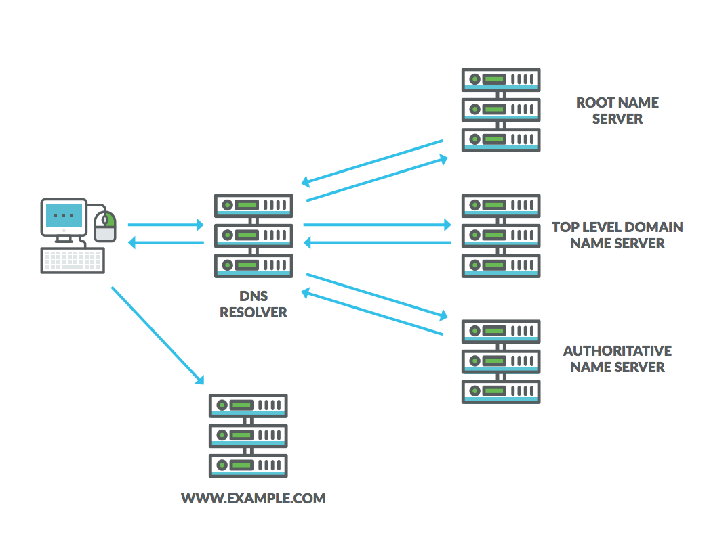
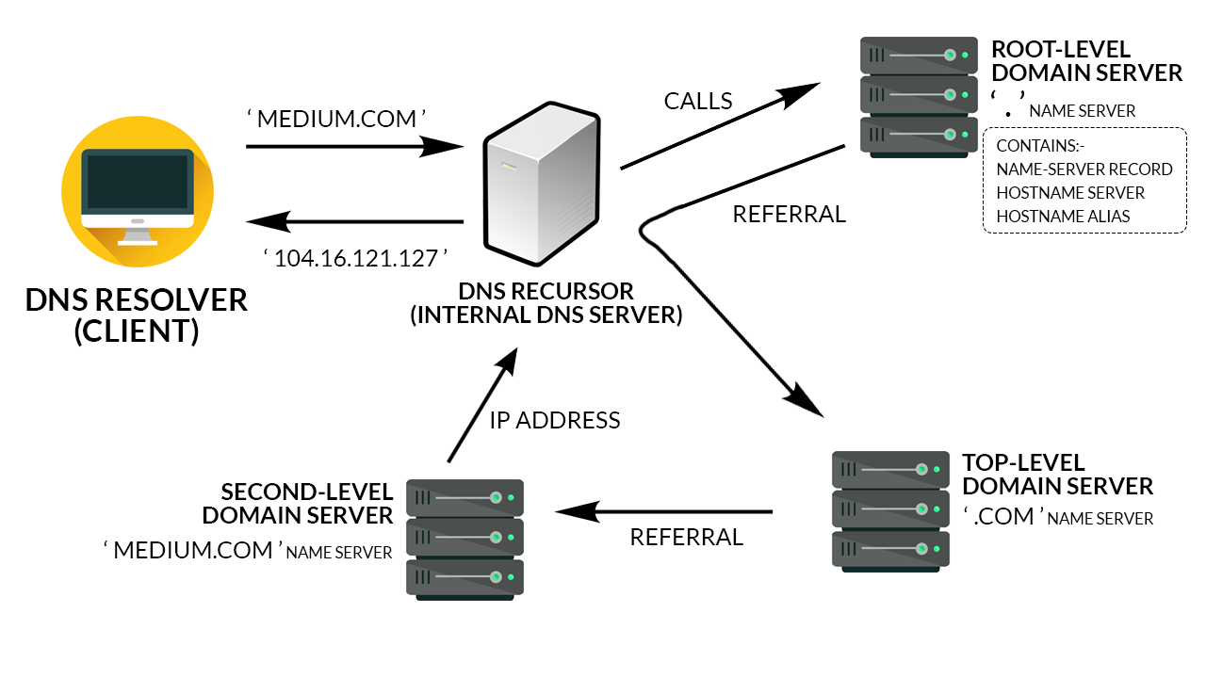
In The Future Implementation & Realization HTI’s Domain Control System As Registrar Level
To Future Approach HTI Domain Control System Diagram Brief
To Future Approach HTI Domain Control System DNS Queries Step Flow

Slide 10
Plan and procedures to update compatibility with the Registry system’s update and upgrade of DNS system and EPP System.
Regular system updates and patching provides a mechanism to manage and protect hardware and software from security and functional issues. System updates can take the form of firmware, software, or physical hardware updates relevant to any vulnerabilities in a particular piece of hardware, software or system appliance.
The following procedures apply to all update processes:
Updates may be performed manually, using administrative tools, or automatically using vendor or internally provided vehicles.
All workstations and user systems/application (as applicable) shall have current operating system and application versions. These systems shall be patched on a regular basis as established by management.
Server and enterprise application updates shall be performed by a qualified and authorized system administrator after the update has been tested in a production environment. Assuming software compatibility, servers shall have current versions of the operating systems and associated If automatic update ability is available, it should be compared to the listing of posted updates to be sure it is accurate.
When there are the Registry system’s update and upgrade of DNS system and EPP System, we will proceed to update the system compatibility by the guidance of PTD.

Slide 11
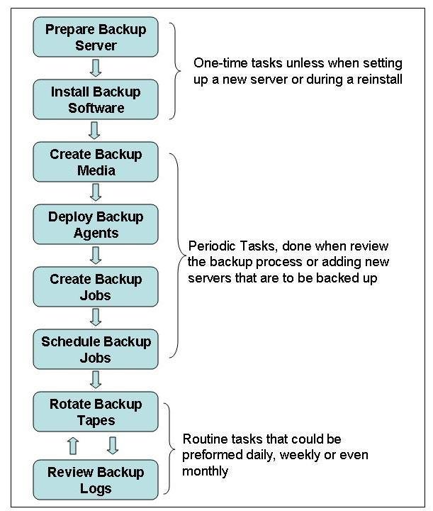
Policy and procedures of system operation management, data backup system and frequency, data retention period for business.
Purpose of procedures
The procedures support Operational Policy and provide guidance on activities and responsibilities in relation to the system operation.
Hardware Management
Software Management
Application Security
Physical Security
Backup Management

Slide 12
Plan and procedures to update compatibility with the Registry system’s update and upgrade of DNS system and EPP System.
Regular system updates and patching provides a mechanism to manage and protect hardware and software from security and functional issues. System updates can take the form of firmware, software, or physical hardware updates relevant to any vulnerabilities in a particular piece of hardware, software or system appliance.
The following procedures apply to all update processes:
Updates may be performed manually, using administrative tools, or automatically using vendor or internally provided vehicles.
All workstations and user systems/application (as applicable) shall have current operating system and application versions. These systems shall be patched on a regular basis as established by management.
Server and enterprise application updates shall be performed by a qualified and authorized system administrator after the update has been tested in a non16 production environment. Assuming software compatibility, servers shall have current versions of the operating systems and associated If automatic update ability is available, it should be compared to the listing of posted updates to be sure it is accurate.
When there are the Registry system’s update and upgrade of DNS system and EPP System, we will proceed to update the system compatibility by the guidance of PTD.

Slide 13
Data retention period for business
The need to retain data varies widely with the type of data and the purpose for which it was collected. It strives to ensure that data is only retained for the period necessary to fulfil the purpose for which it was collected and is fully deleted when no longer required. It may be collected the personal information through the 17 access and use of website, web-based applications, or mobile applications, during conversations or correspondence with our representatives, or when purchase services or complete an online application form:
We may collect personal information from you in connection with:
service orders, activations, and registrations - profile creation and user verification for online services
information requests or complaints - marketing, newsletter or support subscriptions
contest entries or survey participation
payment method applications
event registration
visits or browsing on our websites
personal and business contact information, such as name, address, telephone number, and email address Data retention period for the account or personal information is 1-years ~3-years after the service expiration date or account deletion.

Slide 14
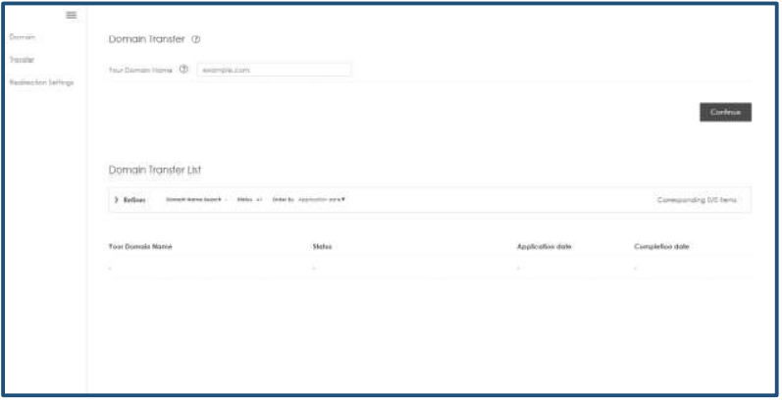
The applicant must have a plan to transfer the domain name to another registrar if the Applicant is unable to continue the management of domain names.
Transfer In
Customer may Transfer In the Domain Name in accordance with the procedure in accordance with the .mm Registry Transfer Regulations;
Transfer Out
Customer may Transfer out the Domain Name during the Registration Period in accordance with the procedure stipulated by us. In the event customer applies for a Transfer Out of the Domain Name, it shall be terminated as of the date of completion of the Transfer Out.

Slide 15
THANKS YOU SO MUCH

